Slide 1
Key Sociological Concepts

Slide 2
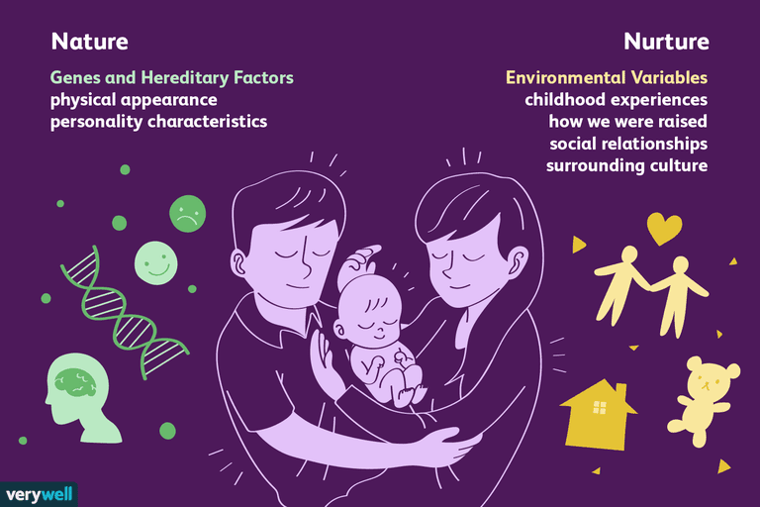
The Nature vs. Nurture Debate
“Your postcode can reveal more about your life than your genes.”
What does this mean to you?
Do we behave as we do because of our genes or our environment?
Where does the colour of your eyes come from?
The answer is your parents... But is that nature or nurture?
Notes:
We will discuss the answers to these questions in class

Slide 3
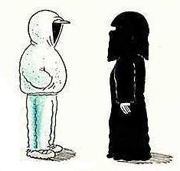
Culture
Can refer to traditional arts such as the theatre, ballet or literature.
In Sociology, however, culture means:
The values, customs and acceptable behaviour shared by members in a society or by members of a social group within a society
What do YOU think are the key words in this definition and why?

Slide 4
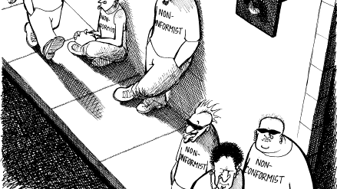
Social Behaviour
Our behaviour is ‘social’
Not random but patterned;
These patterns are shared with others
They also are rejected by others
We live in social groups, not as isolated individuals.

Slide 5
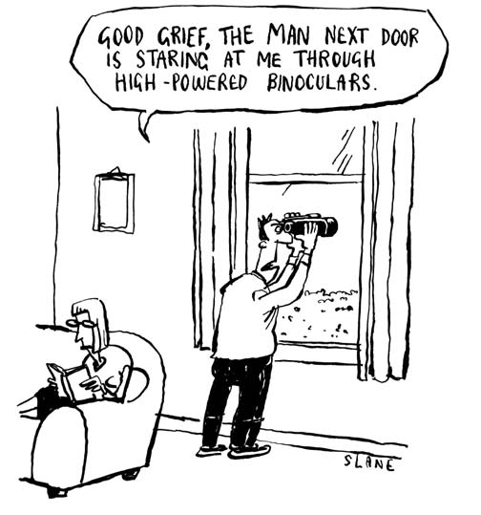
Ideology = Norms and Values
Norms
Values
Social rules
Correct and acceptable behaviour in a society/group
People are expected to conform
More specific than values
Identify the values in practice
Saying hello to your neighbour
‘Right’ or ‘Wrong’,
Core standards
Respect for human life
Guidelines for human behaviour
Norms and Values both shape and are shaped by laws… But they are not the same!

Slide 6

What Norms & Values Can YOU Think Of?

Slide 7
“Isn’t Sociology Just About Common Sense?”
First of all, what is common sense?
Is it universal?
Has it ever changed?
The answer to these questions highlight how Sociology is NOT common sense
Instead it is the observation and commentary of society and societal changes

Slide 8
What Are These Examples Of?
Queuing
Right of privacy
Learning how to use a knife and fork
Children from low-income families performing poorly at school
Having red hair

Slide 9
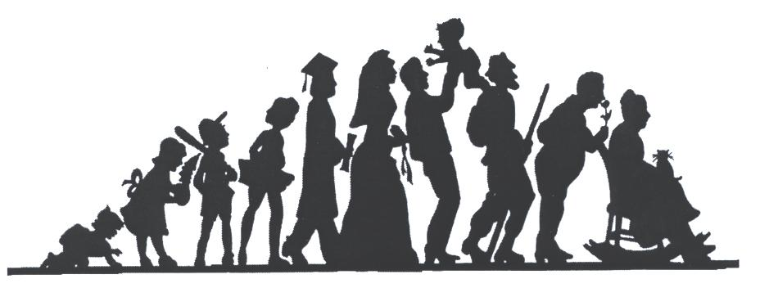
Socialisation
How we learn human behaviour and culture
The process of learning the culture of our society is called socialisation.
Socialisation is an ongoing process...
Can you think of people, places, institutions that socialise people?

Slide 10
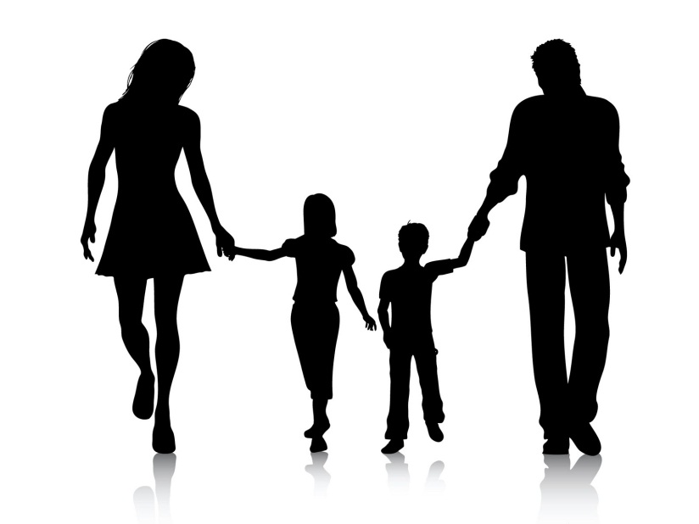

Stages of Socialisation
Primary Socialisation
Secondary Socialisation
Usually centred on the family.
Children learn many of basic lessons for life
E.G. Manners
Occurs as children grow up and move into wider world
E.G. students going off to university, getting a job

